Slide 1
Flight Automation Workshop

Slide 2

Objection & Agenda
Objection
Increase Skillset in Selenium Scripting
Allow interaction with other applications
MVP, AOS, Mobile, MyAccount, IPS
Enhance the opportunity to progress to Test Engineer technical assessment and behavioral assessment
Agenda
Increase Skillset in Selenium Scripting
Workshop is to help (task driven / question driven)

Slide 3
Week 1 – Installing the Framework
Xframium
Do I have the framework installed on my machine?
Do I have the latest version installed?
POM.xml
Xframium-Driver Xframium-Java
Where do I access the latest version?
What Next
How do I install the Framework?
Clone Github process
Update Java version
How do I install the latest Version?
POM.xml
1.0.14 currently latest version
Do I have access to the Share Drive?
Framework Tools
Useful Links
Xframium Website

Slide 4
Week 2 – Configuring Automated Framework
Configuration Files
Application Registry
Cloud Registry
Device Registry
Page Elements
Test Suite
Driver Config
What Next
Create Project Folder
Add Config Files to Project Folder
Page Elements / Descriptors
Configuration Files

Slide 5
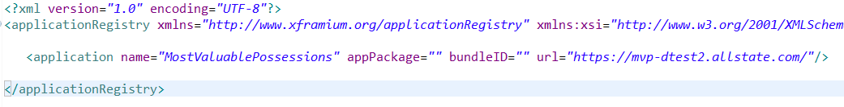
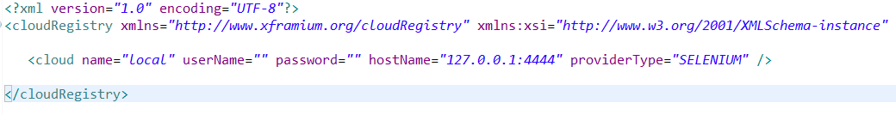
ApplicationRegistry.xml
CloudRegistry.xml

Slide 6
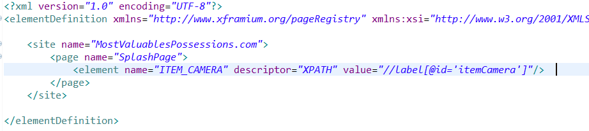
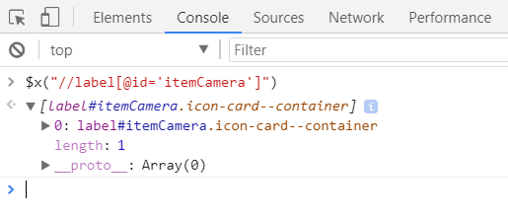
PageElements.xml
XPATH Syntax
//tagname[@attribute=‘ ‘]
e.g. //label[@id=‘itemCamera’]
Checking XPATHs:
Open Inspector in Chrome
$x(“XPATH”)
e.g. $x(“//label[@id=‘itemCamera’]”)
Try populating the pageElements.xml file with the remaining 5 items on the MVP Splash Page
https://mvp-itest1.allstate.com/

Slide 7
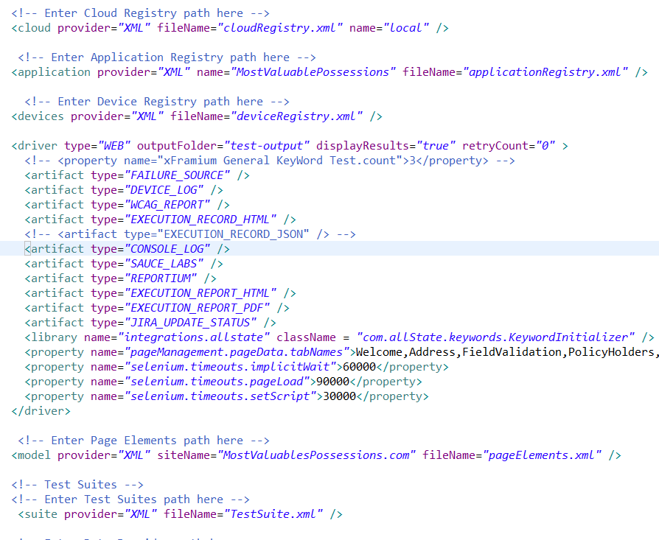
DriverConfig

Slide 8
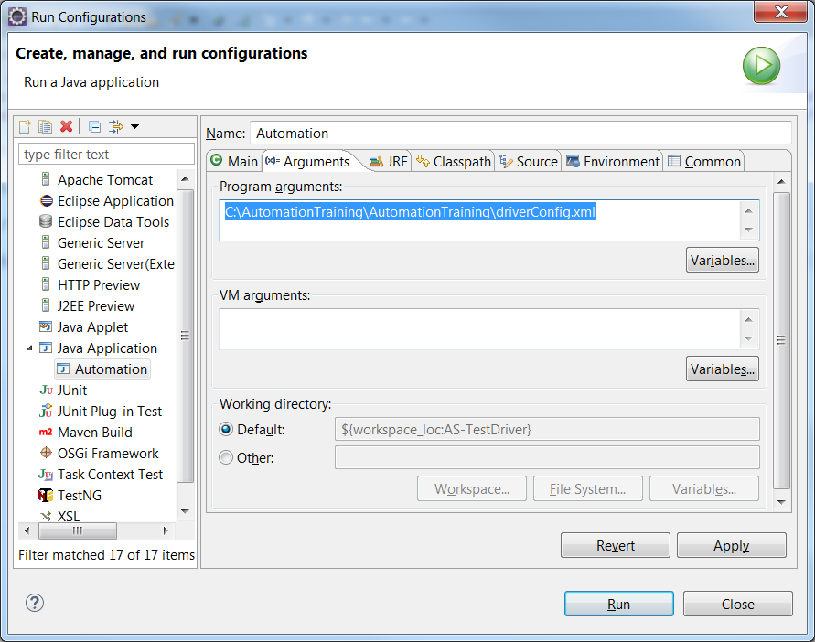
Week 3 – Writing and Running a Test
Run Configuration
Get location of DriverConfig.xml and paste it into program arguments for AS-TestDriver.

Slide 9

Week 3 – Writing and Running a Test
Test Template
Test name = Can be anything but make it something memorable for that test and follow same format for all tests.
active = Can be true or false and determines whether or not that test is executed
Step name = This will be the page element that this step is performed on
page = This is the page that the element is located on
type= This is the keyword that will decide which action is performed on the element

Slide 10
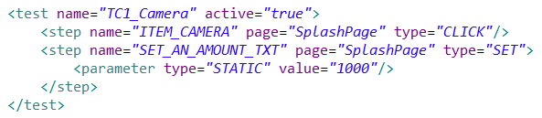
Week 3 – Writing and Running a Test
Test Example
This test clicks the Camera icon and enters 1000 into the price input.
Parameters
Some keywords can include parameters to change how exactly that step is performed. In the example above the parameter within the SET step, sets the value of the ‘Set an Amount’ field to 1000.

Slide 11


Week 3 – Test Data and Data Providers
Test Data
In the previous example, the parameter type was set to STATIC.
It is also possible to use data values from a data source by setting the parameter type to DATA
This means that if a value is changed, it only needs to be changed at the data source rather than going through each individual test and changing the STATIC value.
Data Sources
The framework allows for the use of data from an .xml file or from an Excel file.
This is configured in the driverConfig.xml by adding a data provider.

Slide 12
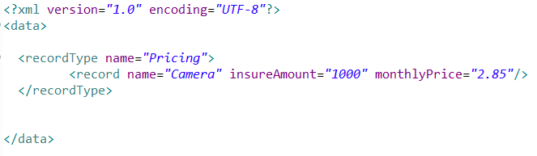
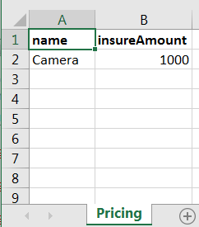
Week 3 – Test Data and Data Providers
TestData.xml
TestData.xlsx
It is important to remember that if you are using Excel as the Data Provider, you must add tab names into the driverConfig.xml

Slide 13
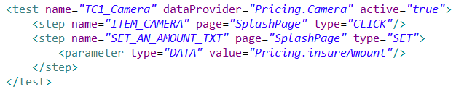
Week 3 – Test Data and Data Providers
Test Data Example
This is the same test as before but using a value provided by a data source rather than a static value
Note that there is an additional attribute within the <test> tag. This is the dataProvider and determines what data will be used in this test.
Pricing.Camera refers to the record type and the name of the record that is being used.
The data value Pricing.insureAmount select the value that is stored in the insureAmount column for that record.

Slide 14
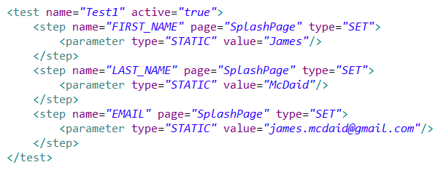
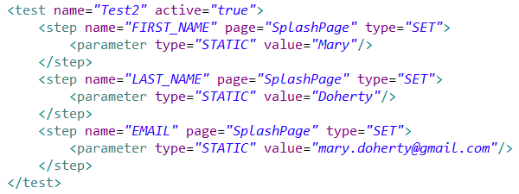
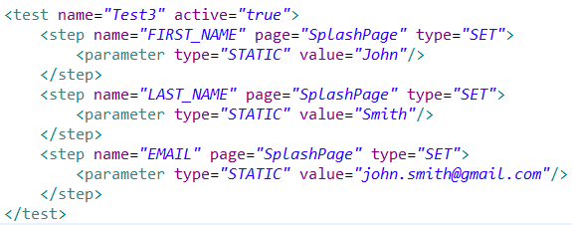
Week 4 – Functions
Sometimes you may find that a test executes the exact same group of steps as another test. This means that the same steps would have to be unnecessarily written out over and over again like below.
This can quickly become difficult to manage and will start to crowd the test suite. However, through the use of Test Data and Functions this can be minimised and made much easier to manage.

Slide 15
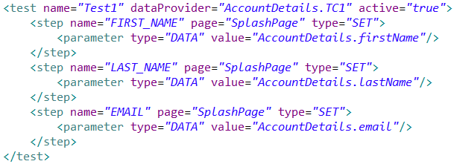
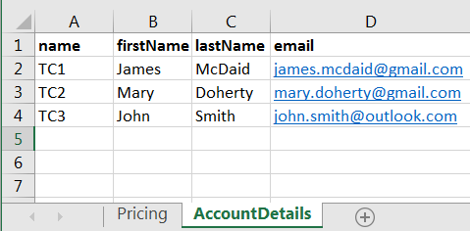
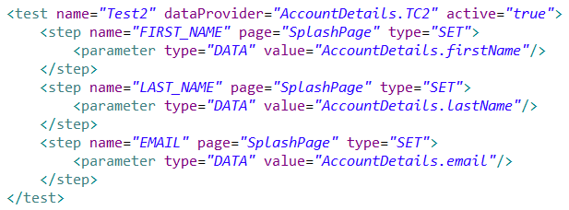
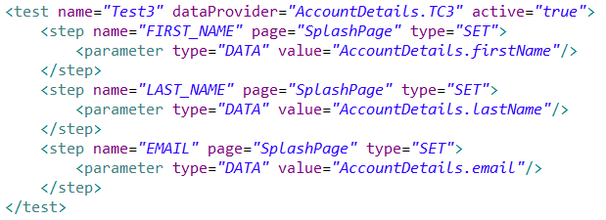
Week 4 – Functions
The 3 tests are each using the same 3 steps. The only difference, is the STATIC values that are being set for each field.
If Test Data is created for those tests, then the 3 steps become identical.

Slide 16
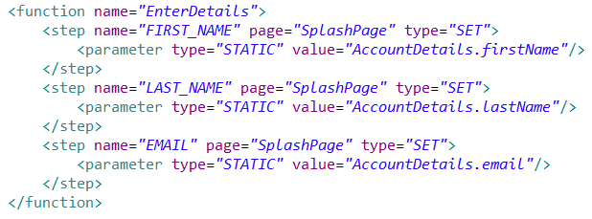
Week 4 – Functions
Now that the 3 steps in each of the 3 tests are the exact same, they can be separated into their own Function.
Functions are kept outside the test, so they are not contained within the <test> tags.
They are only given a name attribute and do not require to be set to active
They are not executed unless they are called from within a test.

Slide 17
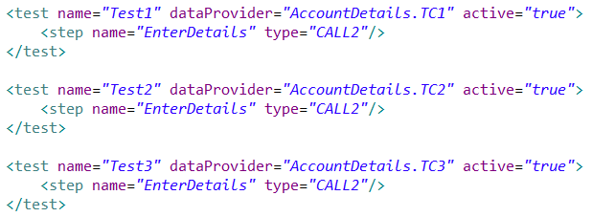
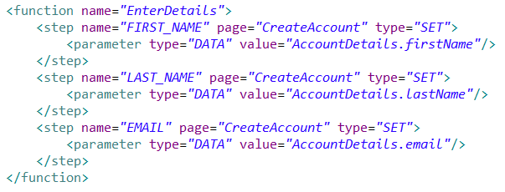
Week 4 – Functions
The function is called in a Step within the test using the CALL2 keyword.
The step only requires a name attribute, which is the name of the function to call, and a type attribute for the CALL2 keyword.
The 3 tests now only have a single line, and the function can be re-used as many times as it is needed.
Each test calls the function, but they are using their own dataProvider to determine which data the function uses

Slide 18
Week 4 – Functions
Functions can be stored in the same file as the tests which are calling them, or they can be stored in a separate .xml file and imported into the test suite.
If a function is being imported from another file, you must add the following line to the top of your test suite:
filename is simply whatever name you decide to call the file, but it is important to remember that if the file is not located in the same folder as the test suite, you will need to include the relative path rather than just the name.

Slide 19
Recap – Questions?
Set up and configuration of Xframium Framework and necessary configuration files.
Using XPATH to locate elements on a web page and store them in a page elements file
Writing and executing a test with static data
Using CLICK and SET keywords along with parameters for test steps
Creating test data for use within tests – XML or EXCEL data providers
Creating functions to store reusable steps for easier maintenance of test steps.
Remember the Slack channel is always available!
#ani-xframium-help

Slide 20
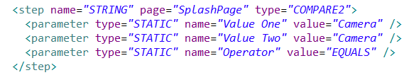

Week 5 – COMPARE Keyword
COMPARE
The COMPARE keyword (written as COMPARE2) can be used to compare two objects. It can compare Strings, Dates, Numbers and Decimals, and can check that the values are equal or greater than one another.
By default the COMPARE2 keyword uses EQUALS as its Operator parameter so it is not necessary to include it if the step is checking that 2 values are the same.
This can be used to check that a static value matches a value that is stored in test data.

Slide 21

Week 5 – GET Keyword
GET
The GET keyword can be used to get the value of an object. This value can then be stored in a CONTEXT variable and used again in future steps within the test.
This will get the value of the element called CAMERA_NAME and store that value in a context variable called CameraName
The COMPARE2 keyword can then be used to check that the value in the CameraName value matches the value stored in the test data.

Slide 22
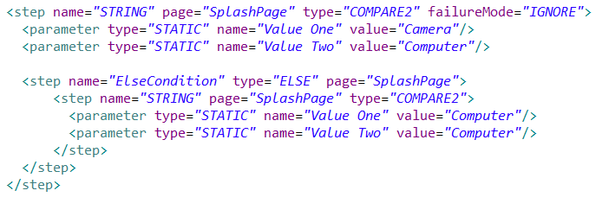
Week 5 – ELSE Keyword
ELSE
The ELSE keyword is a special keyword that will only execute if the parent step fails.
It can be used in conjunction with the COMPARE2 keyword to control flow through the application, similar to “if-else” statements in other programming languages.
The first step will fail as Camera and Computer do not match, however the ELSE step will trigger the sub-step and compare Computer against Computer which will pass.
The addition of failureMode=“IGNORE” allows the test to continue executing even after a step has failed.

Slide 23
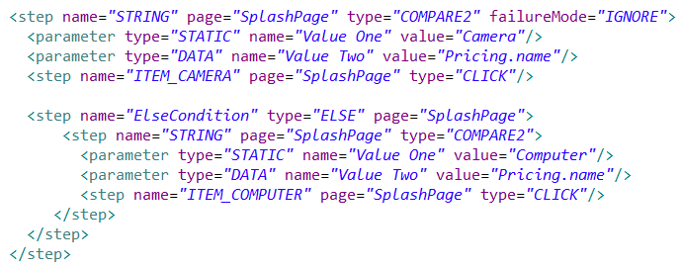
Week 5 – COMPARE/ELSE Keywords
The example below will check the static value Camera against the current data record that is being used in this test. If the data contains Camera, then it will click the ITEM_CAMERA on the splash page. If it does not contain Camera, it will execute the ELSE step and check if the data contains Computer, and click the ITEM_COMPUTER instead.

Slide 24

Week 6 – RANDOM Keyword
The RANDOM keyword allows test data to be generated at random and is only used for that particular test execution. It can be used to generate a variety of random data including Text, Dates, Numbers and Emails.
Randomly generated data can be beneficial in certain situations, such as entering details to create an account and ensuring that an existing email address is not used.
The RANDOM keyword uses the ‘name’ attribute to determine what type of data is to be randomized, and can use a number of parameters to further refine the generated data. The randomly generated value is stored in a context variable for further use.
This example generates a random text value and stores it in the context variable called RandomText.
The parameter is used to determine the format that the value will take. In this case it will follow the format of an upper case letter, followed by 5 lower case letters and a single number.

Slide 25
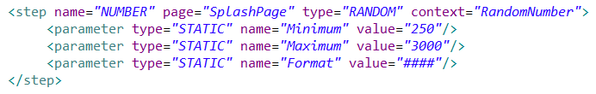
Week 6 – RANDOM Keyword
As well as generating random Text values, the RANDOM keyword can be used to generate random numbers.
There are 3 parameters used in this step; Minimum, Maximum and Format. They are used to set the range that the random number will fall between, and what format the number should take.
The example below will generate a random number between 250 and 3000, using the format ####, and store it in the Context variable RandomNumber. The format can be changed to suit different needs. Eg for currency the format may be $#,###.##
This can be used to enter different numeric values when executing a test rather than using the same set of numbers over and over again.

Slide 26
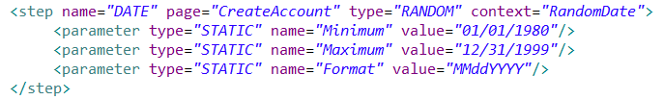
Week 6 – RANDOM Keyword
When using the RANDOM keyword to generate a date, it can use the same three parameters as Number. They can be used to generate a random date that falls between 2 other dates, and determine what format the date should be stored as.
The example below will pick a random date between 01/01/1980 and 12/31/1999, and store it in the Context variable RandomDate, using the format of MM/DD/YYYY.

Slide 27
Week 6 – RANDOM Keyword
The RANDOM keyword can be used to generate First and Last names. These are different than simply using TEXT, as TEXT will return random characters in a string, whereas FIRST_NAME or LAST_NAME will return an actual name that makes sense.
They do not require any parameters and simply store the Random name in a context variable.
The 2 steps below will generate a random First Name and store it in the RandomFirstName context variable, and generate a random Last Name and store it in the RandomLastName context variable.

Slide 28
Week 6 – RANDOM Keyword
When using the RANDOM keyword to generate a random address, there are multiple Context variables created.
Much like FIRST_NAME and LAST_NAME, ADDRESS only requires a single line step with no parameters.
However, rather than just storing an address in a single context variable called RandomAddress, several context variables are created for the various lines of a street address.
They follow the format below:
[contextName]_ADDRESS_ONE
[contextName]_CITY
[contextName]_STREET
[contextName]_STATE
[contextName]_HOUSE_NUMBER
[contextName]_ZIP
Each of these variables can be used individually or not used at all
So, this example will be as follows:
RandomAddress_ADDRESS_ONE
RandomAddress _CITY
RandomAddress _STREET
RandomAddress _STATE
RandomAddress _HOUSE_NUMBER
RandomAddress _ZIP

Slide 29
Week 6 – RANDOM Keyword
Email addresses can also be generated using the RANDOM keyword.
They can include an optional parameter called Domain, which lets you decide what domain you want the random email to include. If this parameter is not specified then a random domain will be used.
This example will generate a random email with the Domain mvpmail.com and store it in the RandomEmail context variable.
The value output will look something like: firstname.lastname@mvpmail.com

Slide 30


Week 6 – RANDOM Keyword
After the RANDOM keyword has been used to generate the random data and store it in context variables, the variable must then be called for it to actually input that data.
So, where we previously used the parameter type DATA to input a First Name like below:
We now use the parameter type CONTEXT to call the context variable RandomFirstName which was created in the step above it

Slide 31
Week 7 – ATTRIBUTE Keyword
The ATTRIBUTE keyword can be used to check various attributes of a web element, and validate that the expected content is contained within that attribute.
Once the attribute of an element is obtained, it can be stored in a context variable and used again later in the application to check that it’s value is consistent throughout.
The example below shows the basic format the step will take. It uses one parameter to determine which attribute’s value is being stored in the context variable.
In this case the value of the attribute textContent is being stored in the context variable MonthlyPrice

Slide 32

Week 7 – ATTRIBUTE Keyword
A second parameter can also be used in the ATTRIBUTE step.
This optional parameter compares the value obtained from the attribute against a known value and will validate that they are the same.
So, if it is known that the expected value should be “2 85”, then this second parameter can be added to compare that the textContent attribute is the same as “2 85”
After comparing the values, the textContent attribute is still stored in the context variable, ready for use again if needed later in the application.
Using the 2 parameters like this will only work if the 2 values are an exact match
So, this example will actually fail because the textContent is “$ 2 85”, but the static value does not have the $ included.

Slide 33
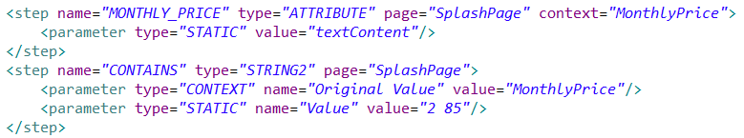
Week 7 – ATTRIBUTE Keyword
Rather than checking that both values are an identical match, it is also possible to check for a partial match.
So in this case the Value of the Attribute is obtained and stored in the Context variable, without comparing it to anything else yet.
Then the context variable is used in another step to check that it CONTAINS the expected value.
The CONTAINS functionality is part of a diverse keyword called STRING2, which can be used to perform a number of different operations in relation to Strings.
The CONTAINS step uses 2 parameters to check a Value against an Original Value.
So, this example will be successful, as the Value “2 85” is contained within the Original Value “$2 85” even though it is not an exact match.

Slide 34
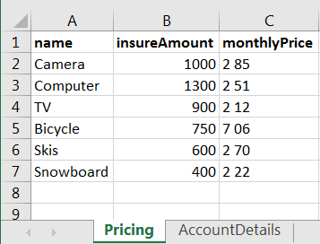
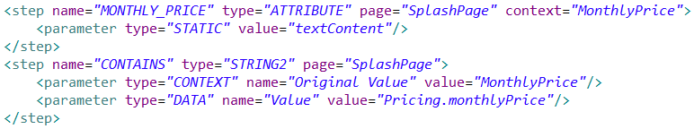
Week 7 – ATTRIBUTE Keyword
The previous example used a STATIC value of “2 85”, but we can use the DATA type for the parameter instead to check the Attribute value against test data for expected results of multiple outcomes.
We can add another column to our test data for Pricing information called monthlyPrice, and then use this to check that the value displayed on screen contains the expected value.

Slide 35
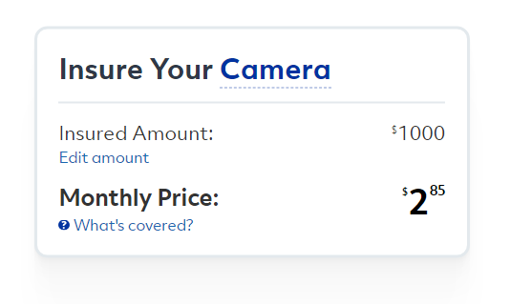
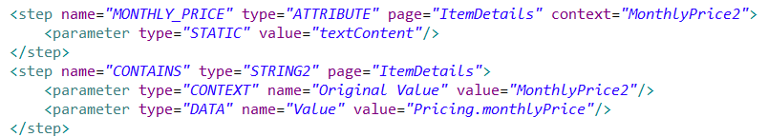
Week 7 – ATTRIBUTE Keyword
The CONTAINS keyword can be used to verify that a particular value is carried throughout the application
The example of Monthly Price appears again after the create account screen.
So, a similar step is used to get the Attribute value for this monthly price, and check that it contains the value in the test data.

Slide 36
Week 7 – ATTRIBUTE Keyword
The CONTAINS keyword can be used to check a variety of element attributes at different points in the application.
The step can easily be inserted into the existing function and will then apply to the 6 different tests for each item.
Looking at the screenshot below, the Item Name, Insure Amount and Monthly Price are all elements that could be checked and validated that the correct information is being carried over and displayed.

Slide 37
Week 8 – LOOP Keyword
The LOOP keyword can be used to repeat a set of steps, or a function, a set amount of times.
This allows for great re-usability of code as it allows test scripts to simply iterate through a loop using different values, rather than having a completely separate set of steps to achieve a similar result
An example of where this may be useful is when multiple drivers are getting insured on one vehicle
The LOOP step will be able to iterate through a set of steps that enters driver details for multiple drivers, rather than using the same set of steps over again to enter details for additional drivers.
The loop step uses 2 parameters; the Loop Iterator and the Function Name. The Loop Iterator determines how many times the loop will execute before exiting the loop, and the Function Name is used to call the set of steps that execute within the loop.

Slide 38


Week 8 – LOOP Keyword
In the case of a Numerical Loop, the Loop Iterator uses a STATIC parameter and a numeric value to determine how many times the Function is called in the loop before continuing on with the rest of the test script.
In the case of a Data Driver Loop, the Loop Iterator still uses a STATIC parameter, but instead of using a numeric value, it will instead iterate over a data table containing records.

Slide 39
Week 8 – LOOP Keyword
When using data to iterate through the loop, a Child table can be created that contains the data, and is accessed from the Parent table.
The records within the Child table are accessed from the parent table using the following syntax: |childRecords:[value='childOne’]|
This is broken down as follows:
childRecords = Name of the child table containing the records to loop
Value = Column name within the child table
childOne = A value within the ‘Value’ column
So this will access the table called ‘childRecords’ and will iterate over the records that have the value ‘childOne’ in the ‘Value’ column.

Slide 40
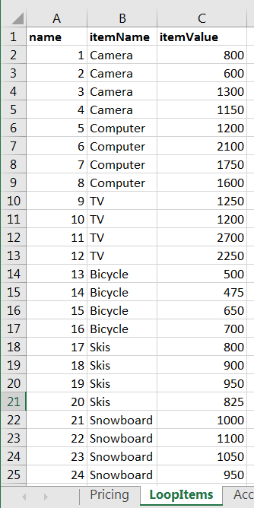
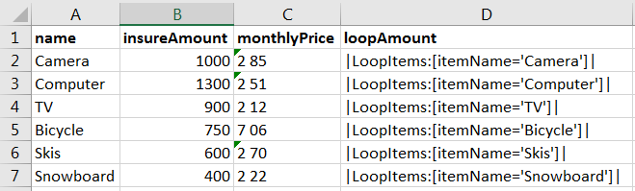
Week 8 – LOOP Keyword
For example, if we have this table called ‘LoopItems’ which contains 4 different prices for each of the Items, we can loop through the 4 values for any particular item.
This data would be accessed from the Parent table ‘Pricing’ using the syntax from the previous slide
So for example, looking below we can see the value: |LoopItems:[itemName=‘Camera’]|
This essentially creates a small table of records where the value in the ‘itemName’ column is equal to ‘Camera’

Slide 41

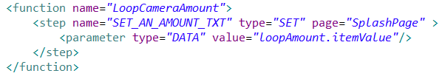
Week 8 – LOOP Keyword
Now that the data is set up correctly we can write a test that uses this data in a loop.
So this step uses the column we added called loopAmount, to access the Child table and will call the function LoopCameraAmount, which simply enters the 4 values associated with Camera.
Below is the function that is being called and shows what the parameter value looks like when using a loop.

Slide 42
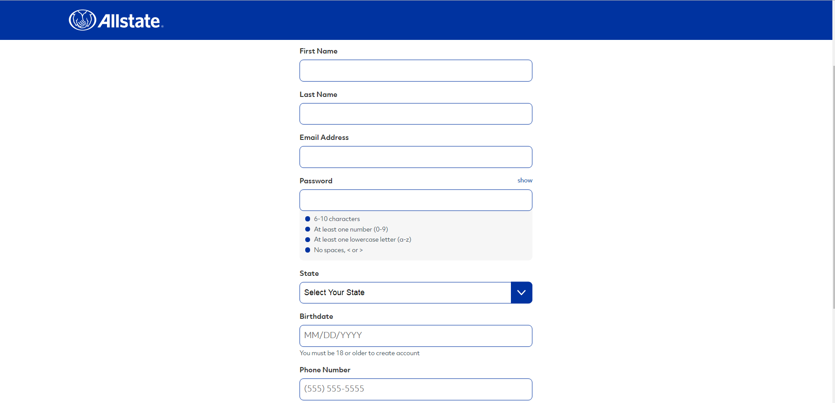
Week 8 – LOOP Keyword
This is a simple example of how a Loop is executed and showing how the data for the loop is set up. This example simply enters 4 different values for an item, but the function that is called in a loop could be as big as is needed.
This deals with looping a set of numbers for a single field, but using the same principles we can also try looping through multiple account details for the create account screen.
Now have a go at entering multiple account details using a Loop

Slide 43
Week 9 – Cross Browser Testing
One of the main benefits of test automation is the ability to execute the same test scripts across a number of different browsers.
This cross browser testing is beneficial as it helps identify any differences in behaviour between the browsers
Automated tests help with this as they will execute the exact same set of steps and removes the potential for human error when manually carrying out the same test on different browsers.
Different browsers can be listed in the deviceRegistry, and the ‘active’ attribute can be set to true or false depending on whether or not the tests should be executed against that browser.
The examples below are using the value ‘local’ as the cloud. This simply means they will run against the browsers installed on the local machine using the selenium grid.

Slide 44
Week 9 – Cross Browser Testing
Selenium Grid allows for parallel execution of tests
If both Google Chrome and Internet Explorer devices are set to true, then they will execute the same test on both browsers simultaneously.
Selenium Grid also allows multiple tests to be ran in parallel on the same browser.
This can be controlled using the ‘availableDevices’ attribute. The value for this attribute is a whole number which determines the maximum number of instances of that browser which can be open at one time.
So, in the example above, 5 separate Chrome windows and 5 separate IE windows would open, assuming there are at least 5 tests to be executed.
If there were more than 5 tests, then all 5 instances of the browser would complete their execution before opening the next.

Slide 45
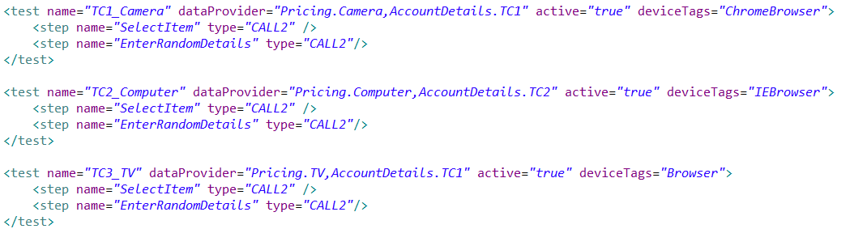
Week 9 – Cross Browser Testing
Another attribute which comes in handy for cross browser testing, is the tagNames attribute.
The tagNames attribute can store a number of comma separated values which relate to that device.
The values can then be added to another attribute in the test or step tags.
So, the test or step will only execute if it has a matching deviceTag for a particular device’s tagName.

Slide 46
Week 9 – Cross Browser Testing
Using the previous screens as examples, we can see the Google Chrome device has 2 tagNames; ChromeBrowser and Browser
The Internet Explorer device also has 2 tagNames; IEBrowser and Browser.
So, both devices share the Browser tag and also have their own unique tag.
So looking at the deviceTags and tagNames used, we should expect the following:
TC1_Camera will execute on Chrome but not IE
TC2_Computer will execute on IE but not Chrome
TC3_TV will execute on both Chrome and IE

Slide 47
Week 9 – Cross Browser Testing
The deviceTags attribute is useful when controlling which tests are executed on different browsers, but it can also be used in individual steps within the test.
This can be helpful if the behaviour of the application slightly differs across browsers. It can then be used to control which steps in the test are executed and which steps in the test are skipped over, depending on the browser that test is running against.
This example is simply to show how a step using deviceTags would look
The deviceTags attribute is added within the step tag and the values work the same way as the previous deviceTags attribute at the test level

Slide 48
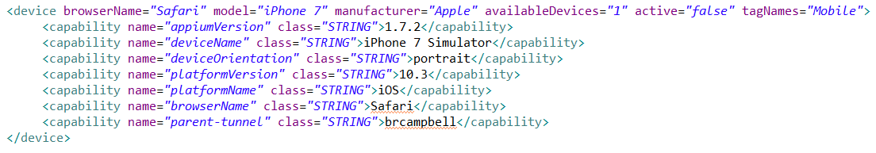
Week 9 – Cross Browser Testing
As well as controlling which browsers tests are executed on, the deviceRegistry can also be used to control what type of devices the tests are run against
These can include local desktop browsers, sauce labs desktop browsers, and mobile devices such as phones and tablets.
The device below is for an iPhone 7 and it has been given the tagName ‘Mobile’
This means that we can simply add a deviceTag attribute to any tests or steps with the value ‘Mobile’ and those tests/steps will only execute when running on a mobile device.
Likewise, if we use the value ‘Browser’, then those tests/steps won’t execute on mobile devices as it does not have the matching tagName.

Slide 49
Week 9 – Cross Browser Testing
The deviceRegistry is where all the various devices and browsers are controlled for test execution
It allows for great customization and a variety of combinations when determining what devices should be used during test execution
Devices can be set to true or false
The max number of parallel instances of a device can be set
Tags can be used in both the deviceRegistry and the test itself to control exactly how a test behaves across different browsers and devices.
The deviceRegistry is an important tool when it comes to test automation and can be very flexible in it’s use.

Slide 50
Week 10 – Selenium Basics
So far, we’ve looked at writing test scripts using xml as part of the Xframium framework
The framework itself makes use of a Selenium and Java backend
Selenium is an open source automation tool that is used to automate web applications
It is platform dependent and can run in many browsers such as Firefox, Chrome and Internet Explorer.
Selenium can be controlled by various programming languages like C#, Python, JavaScript, and in this case, Java

Slide 51
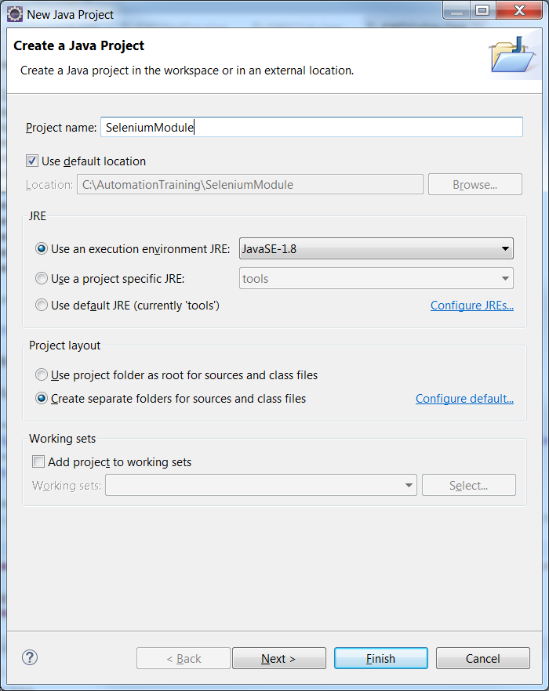
Week 10 – Selenium Basics
Create a new Java project in Eclipse

Slide 52
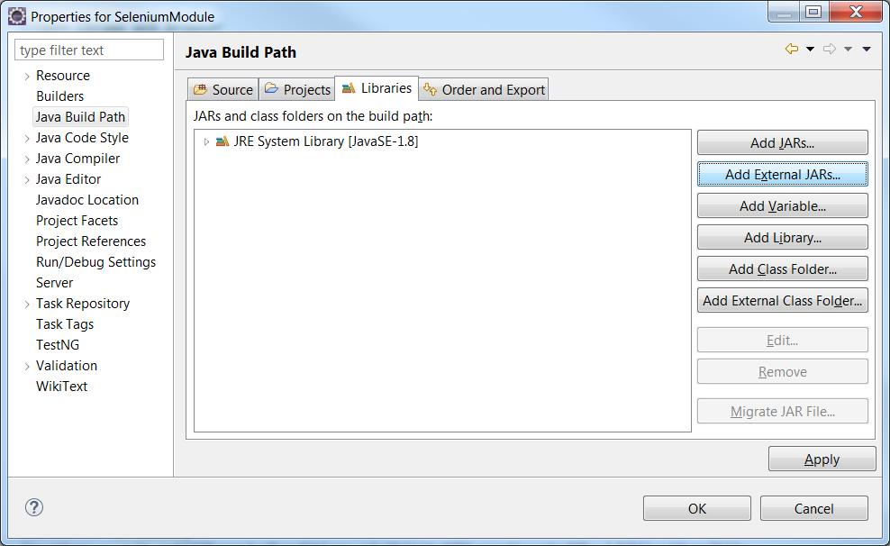
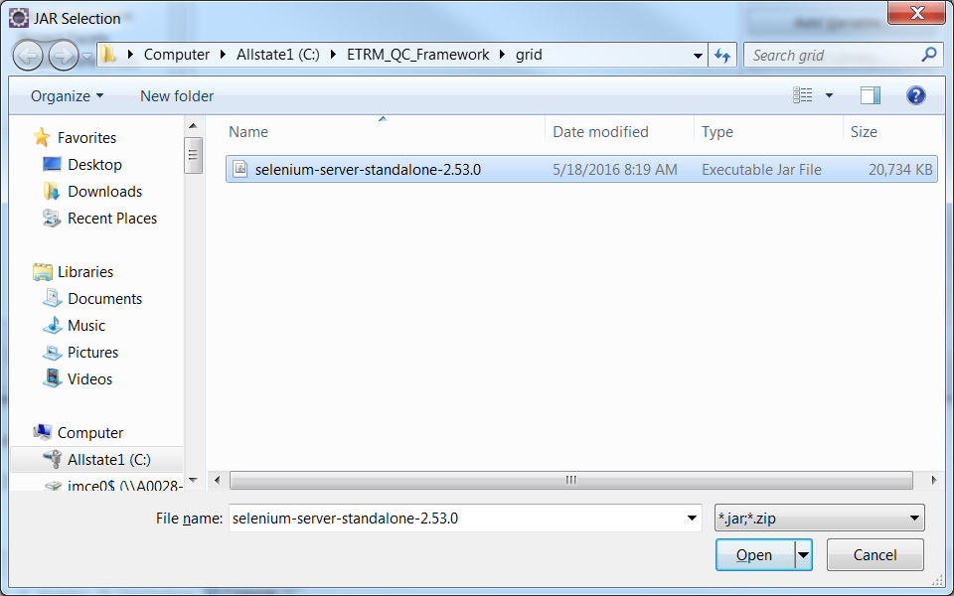
Week 10 – Selenium Basics
Right Click the newly created project > Properties > Java Build Path > Libraries > Add External JARs
Select the selenium executable JAR file from the grid folder

Slide 53
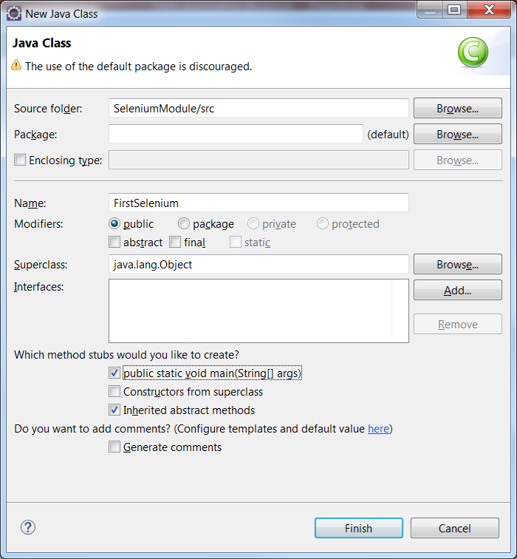
Week 10 – Selenium Basics
Right click the Java Project folder and select New > Class
Give it a name and check the “pubic static void main(String[] args)” box
Click Finish

Slide 54
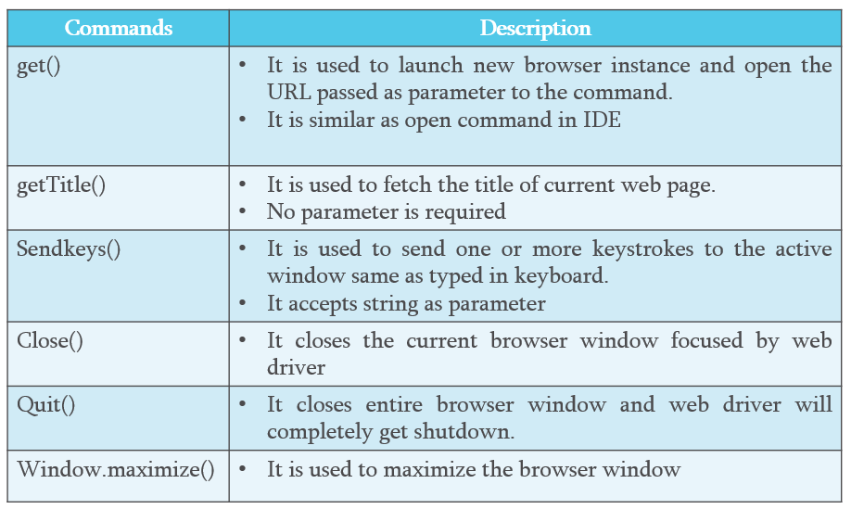
Week 10 – Selenium Basics
Below are some basic Selenium commands that are used to control the test execution.

Slide 55
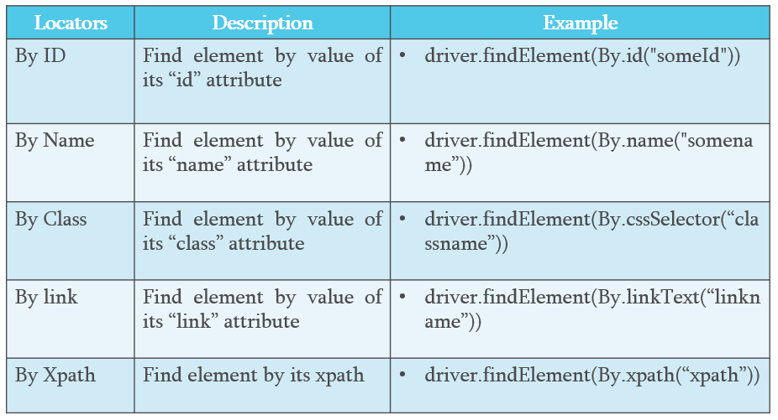
Week 10 – Selenium Basics
Web elements are located using various locators as shown below

Slide 56
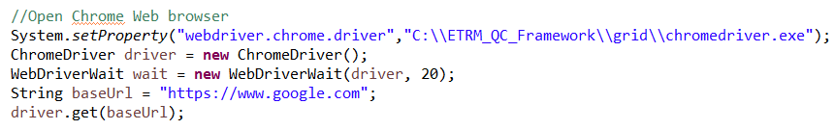
Week 10 – Selenium Basics
The next few slides are going to split up the Java class into the steps needed to navigate to the MVP site, click the Camera Item and enter an Insure Amount.
Firstly, the ChromeDriver must be set up so that a chrome browser can be launched when the test is executed.
This identifies the location of the chromedriver.exe and sets a wait of 20 seconds, which will cause the test to stop execution if any step takes longer than 20 seconds to complete.

Slide 57
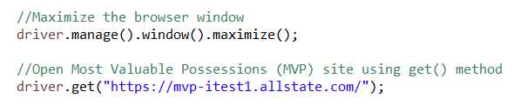

Week 10 – Selenium Basics
Once the Chrome browser has launched, the next steps will maximize the window, and navigate to the MVP site.
The next step will look for a web element on the web page that has the id equal to “itemCamera”
Once this item has been found, it will then click that element

Slide 58
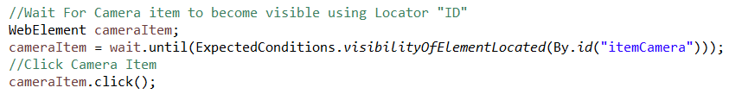
Week 10 – Selenium Basics
The same sync issue will still occur when trying to execute the next step before the element has completely loaded.
The WAIT_FOR keyword was used to wait for the element to be visible on the page before performing the next step.
A similar approach is taken by using the following Java
A new WebElement called cameraItem is created
The 20 second wait will then begin until the element with the id “itemCamera” is located on the page.
Once this element has been found, the camerItem WebElement is clicked.
Alternatively, if the 20 seconds pass and the element has not been found, then the test will fail

Slide 59
Week 10 – Selenium Basics
When entering text into a field, the SET keyword was used previously
Again, a similar approach is taken here by locating the element on the page and using the sendKeys() command to enter 1200 into the Set Insure Amount field.
Here the element is being found by it’s xpath instead of an id, but any locator is valid for finding elements.
Once the value has been entered, the next step is to click the Protect Item button
This works the same way the camera item was clicked, by finding the element on the page using it’s xpath and performing the click() command

Slide 60
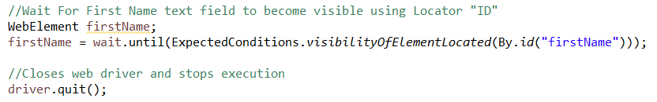
Week 10 – Selenium Basics
When the Protect Item button is clicked, the final step is to check that the correct navigation to the Create Account screen has taken place
This follows the same format as the previous wait statement, this time waiting until the text box to enter first name is visible on the create account screen
The WebDriver does not automatically close the browser after execution, so a quit() command must be added once the test is completed

Slide 61
Week 10 – Selenium Basics
This was a basic introduction to writing a short Java class to run an automated test with Selenium.
The reports that show pass/fail and steps are a part of Xframium so this will not show by sampling executing the Java class.
Xframium has many advantages such as this report, simpler keyword driven test scripts, and it does not require an in depth knowledge of Java or Selenium to be able to create your own tests
As mentioned previously, every keyword in Xframium has Java and Selenium behind it, so advanced users of the framework are able to go and create their own keywords for use in test scripts.

Slide 62
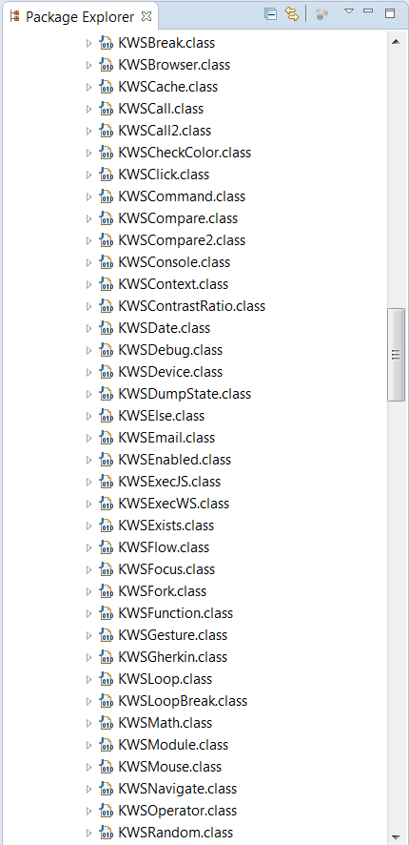
Week 11 – Custom Keywords
As mentioned previously, every keyword used within the Xframium framework has a Java class behind it that determines the functionality that keyword will carry out
The framework has an extensive list of keywords, covering a variety of actions that can be performed, but occasionally, there may not be a keyword to suit the requirements. In this case, a custom keyword can be created.

Slide 63
Week 11 – Custom Keywords
A custom keyword can be created within Eclipse simply by creating a new Java class and adding it to the list of keywords already in use.
As an example we will be looking at creating a keyword which allows files to be uploaded.
This keyword can be useful as it is not possible to do this simply using the keywords already at our disposal.
Selenium webdriver uses the web elements on a page to control actions.
However, when a file needs to be uploaded, it will often bring up a native file explorer depending on the operating system in use.
This means that Selenium can not interact with this explorer as it is not a part of the web application.

Slide 64
Week 11 – Custom Keywords
A custom keyword can be created by adding a new Java file to the com.allState.keywords folder.
In this example we’ll give it the name KWSFileUpload.java
Now that the keyword file has been created,, it must be added to the Keyword initializer so that the framework knows which class to use for that keyword.
This line adds the keywords for use within the framework
The value in inverted commas is the actual keyword that will be used during test steps, such as CLICK and SET, so in this case we will give it the keyword FILE_UPLOAD.
The second value after the comma is the Java class that this keyword will use, so in this case we give it the newly created KWSFileUpload.class

Slide 65
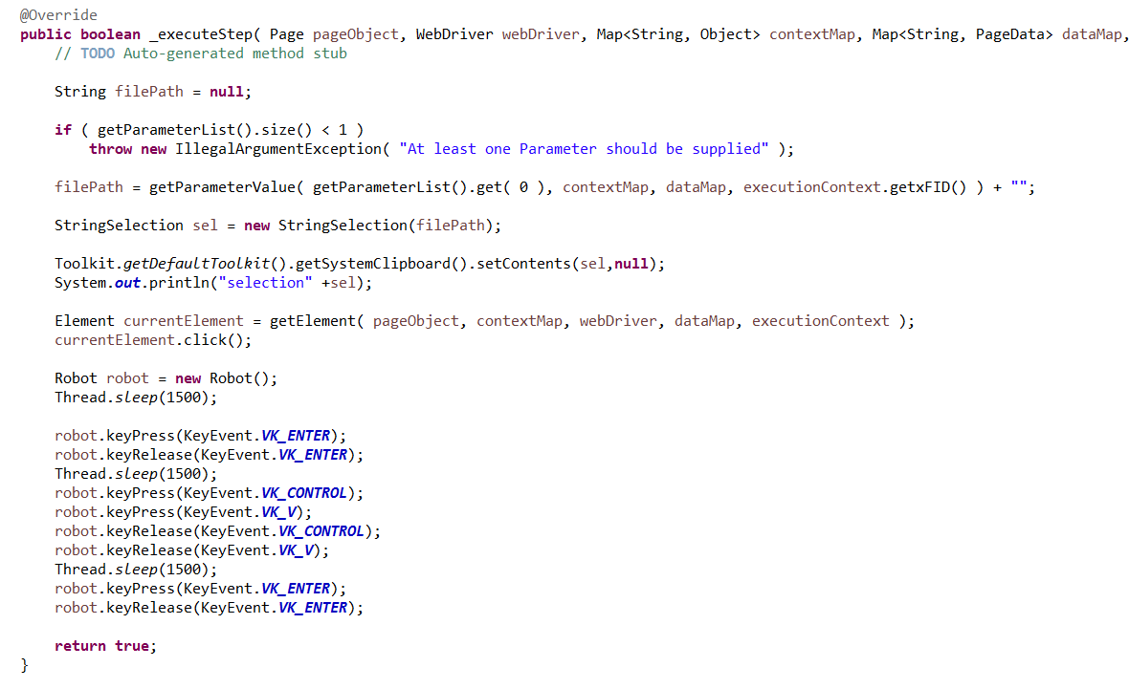
Week 11 – Custom Keywords
This will give you an idea of what a keyword may end up looking like
A few things such as getting parameters and elements are similar to other keywords

Slide 66
Week 11 – Custom Keywords
The important parts that were added to the class for this keyword are as follows:
String filePath -> this creates a filePath variable that we can use to point to the location of our file/photo to upload
systemClipboard -> this will allow us to copy the file path to the clipboard and paste it when the explorer window appears
Robot.keypress/keyRelease -> this creates a new robot that we can use to control key presses and releases.
So looking at the class, we can see that it is taking a parameter and storing it in the filePath string.
Then stores this string on a clipboard for later use.
Then it finds the element that the keyword is being used with and clicks it.
Now that the explorer window is open, the robot takes over and uses key shortcuts to paste the filepath using key presses for CTRL + V, then presses enter to confirm the file and close the explorer dialog.

Slide 67
Week 11 – Custom Keywords
Now, to use the new keyword in a test step
Since the keyword has been added to KeywordInitializer.java, it can be used just like any other keyword in the framework.
The step above shows an example of how this keyword may be used.
We can see it looks just like any other test step and the keyword FILE_UPLOAD is used as the value for ‘type’
Looking at the class for the keyword, we know it is expecting a parameter, so we include a single parameter with the value of our file path.
This file path will then be used in the keyword to find that specific file when the file explorer window appears.
Also, just like other parameters, the type can be changed to DATA and the file path stored in an excel or xml data source

Slide 68
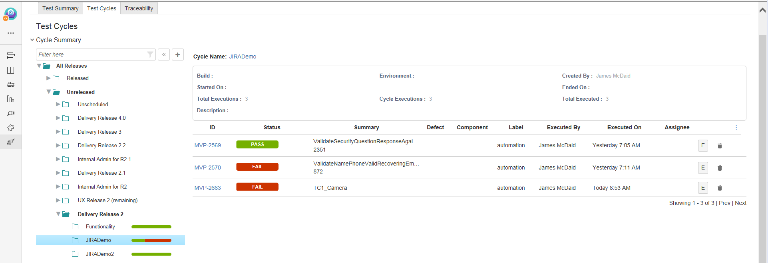
Week 12 – Zephyr and JIRA Integration
Zephyr tests are testing stories that are created in JIRA
These Zephyr tests will use the existing tests from the test suite, and will update the Pass/Fail status of the corresponding Zephyr test within JIRA
The tests can be viewed by anyone within the team who has access to the JIRA board, and the tests themselves will show the test execution history, which will show how the test performed in the past against different builds, or test cycles.
The Zephyr test will also include the Xframium report as a .zip attachment, meaning anyone can download and open the report to see the results for that particular test execution, rather than the reports being stored on the local machine that executed the test.

Slide 69
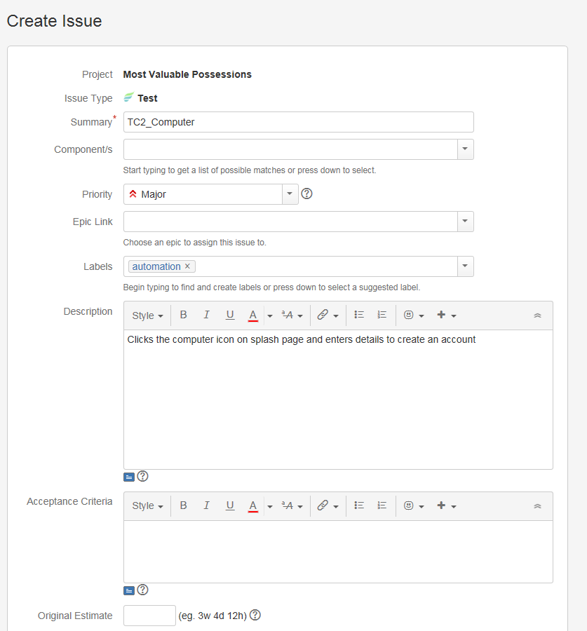
Week 12 – Zephyr and JIRA Integration
Creating a Zephyr test is similar to creating a user story in JIRA
When giving a summary for the test, it is best to use the name of the test for that script, so that it is easy to tie it back to the test suite in eclipse
Also give the test a description of what exactly the test’s purpose is
Labels can be used to easily filter and search for tests at a later date.

Slide 70

Week 12 – Zephyr and JIRA Integration
Once the Zephyr test is created, it will be assigned a story number following the same format as other stories created for that JIRA board
In this case, the test for TC2_Computer is given the story number MVP-2665
This is why the summary field should be the test name, as the story number generated does not give any indication as to what test it is.

Slide 71

Week 12 – Zephyr and JIRA Integration
To link the Zephyr test to the test script in Eclipse, the generated story number is used in a new attribute within the test called linkId
During execution this will then link the test to the story in JIRA for the Zephyr test.
The driverConfig.xml also needs to be updated to allow the JIRA integration during test execution.

Slide 72
Week 12 – Zephyr and JIRA Integration
These properties tie the test driver to the JIRA board to be used
Jira.server is the URL where the JIRA board is located
Jira.username and jira.password are the credentials you use to log in to JIRA
Jira.projectKey is simply the project key for the JIRA board and can be found from it’s URL
Jira.versionname is the version that you want this test execution to come under. This can be different delivery releases, or whatever is required
Jira.cyclename is the test cycle this test execution will belong to. These test cycles could be different build versions
Jira.attachment will include the .zip file of the Xframium report if it is set to true
Jira.credentialSecurity can be used to encrypt the username and password fields rather than being plain text like above.

Slide 73

Week 12 – Zephyr and JIRA Integration
An additional .jar file must also be added to the build path for the test driver.
The jira-1.0.2.jar file should be saved in the .m2 folder under users
Right click AS-TestDriver > Build Path > Configure Build Path to bring up the below screen.
Click Add External JARs and select the jira-1.0.2.jar file.
Click Apply and OK

Slide 74

Week 12 – Zephyr and JIRA Integration
The pom.xml must also be updated to include the following exclusions under the 2 org.xframium dependencies:

Slide 75

Week 12 – Zephyr and JIRA Integration
Now that the test driver has been linked to JIRA, it is simply a case of executing the test for it to show up with it’s execution status
Once execution is complete, the test will show up under the release and test cycle that was set in the driverConfig.xml
Opening the test will show the summary, description, test execution history and the Xframium report attachment for all previous executions of this test.

Slide 76

Week 12 – Zephyr and JIRA Integration
To view the Xframium report for a test execution, the zip file must first be downloaded and extracted to your computer.
The report will not display correctly using the latest version of the framework, as it uses an assets folder which is not included in the zip file.
To get around this, we can set the report template to it’s previous Dark them from earlier versions of the framework and it will show up as normal
To do this, the following line must be added to TestDriver.java:
System.setProperty("reportTemplate", "dark");
This should be added just above the current last line of the test driver:

Slide 77

Week 12 – Zephyr and JIRA Integration
Now the Xramium report can be viewed for that test execution by opening the index.html file extracted earlier.

